Slide 1
Tut 6

Slide 2
Do while loop
The do-while loop looks like this:
do
{
this ;
and this ;
and this ;
and this ;
} while ( this condition is true ) ;

Slide 3
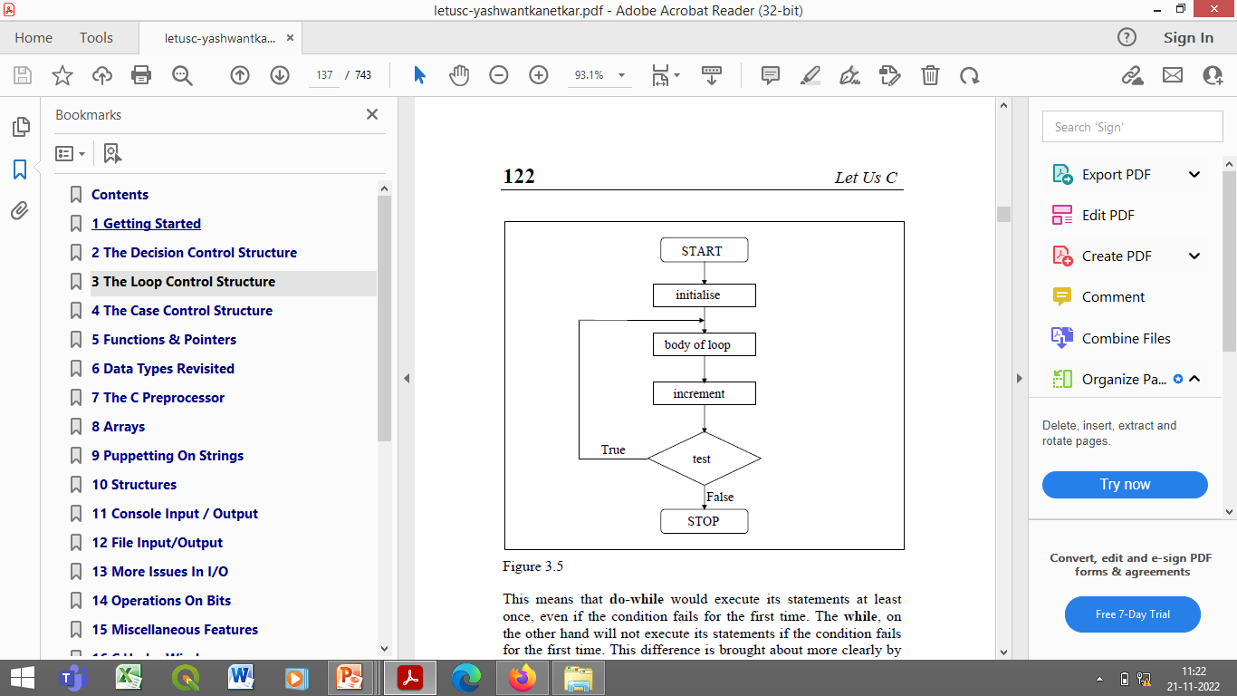
Do while loop
do
{
this ;
and this ;
and this ;
and this ;
} while ( this condition is true ) ;

Slide 4
while vs do while
The place where the condition is tested?
while tests the condition before executing any of the statements within the while loop.
do-while tests the condition after having executed the statements within the loop

Slide 5
main( )
{
while ( 4 < 1 )
printf ( "Hello there \n") ;
}
Since the condition fails the first time itself,
The printf( ) will not get executed at all

Slide 6
main( )
{
do
{
printf ( "Hello there \n") ;
} while ( 4 < 1 ) ;
}
In this program the printf( ) would be executed once,
As first the body of the loop is executed and then the condition is tested.

Slide 7
do while
There are some occasions when we want to execute a loop at least once no matter what.

Slide 8
for loop Programs
W.A.P to find the factorial of a number using for loop
WAP to find the fibonacci series
0 1 1 2 3 5 8
W.A.P to find the sum of the series
1+3+5+….+N
W.A.P to find the sum of series
1!+2!+31+4!+……depending on a limit of user’s choice
W.A.P to print the sum of series 1+1/2+1/3+1/4+…..
W.A.P to print the sum of series 1/1!+2/2!+3/3!+4/4!+…..+N/N!
W.A.P to find the sum of a Series 1 + 1/2² + 1/3³ + …..+ 1/n^{n}
W.A.P to print the sum of series 1+x²/2!+x⁴/4!+x⁶/6!+…..+x^{N}/N!

Slide 9
while loop Programs
W.A.P to evaluate the equation y=x^{n}, n is a non-negative integer
WAP to calculate the factorial of a number using while loop
W.A.P to print the sum of digits of a number
W.A.P to check if a number is a palindrome or not?
W.A.P to check if a number is an Armstrong no or not?
W.A.P that asks the user to enter some numbers & then find their average using while loop

